Slide 1
Introduction and Overview of Single-Cell Platforms
Susan Kloet
Leiden Genome Technology Center (LGTC)
MGC Course on Single-Cell Analysis
23 October 2023

Slide 2
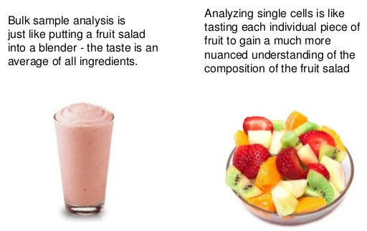
Why single-cell?

Slide 3
Tissues are heterogeneous

Slide 4
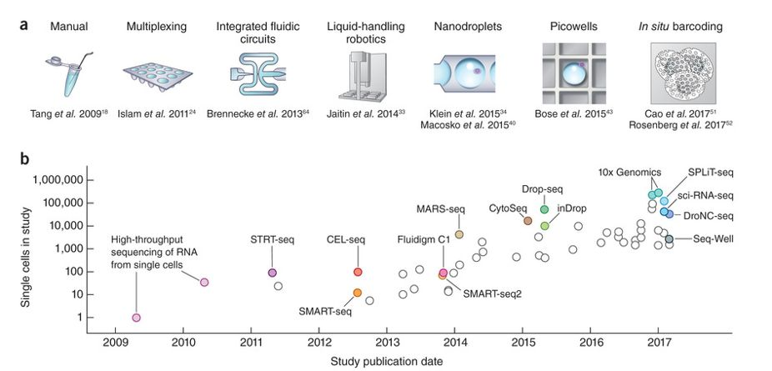
Exponential scaling of single-cell throughput
Svensson et al Nature Protocols 2018

Slide 5
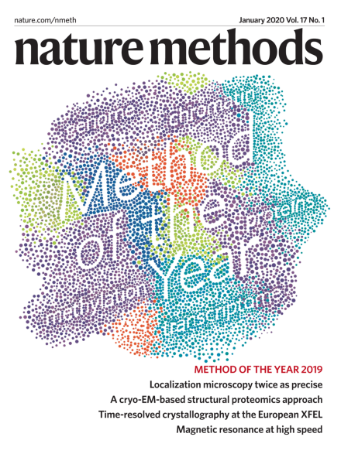

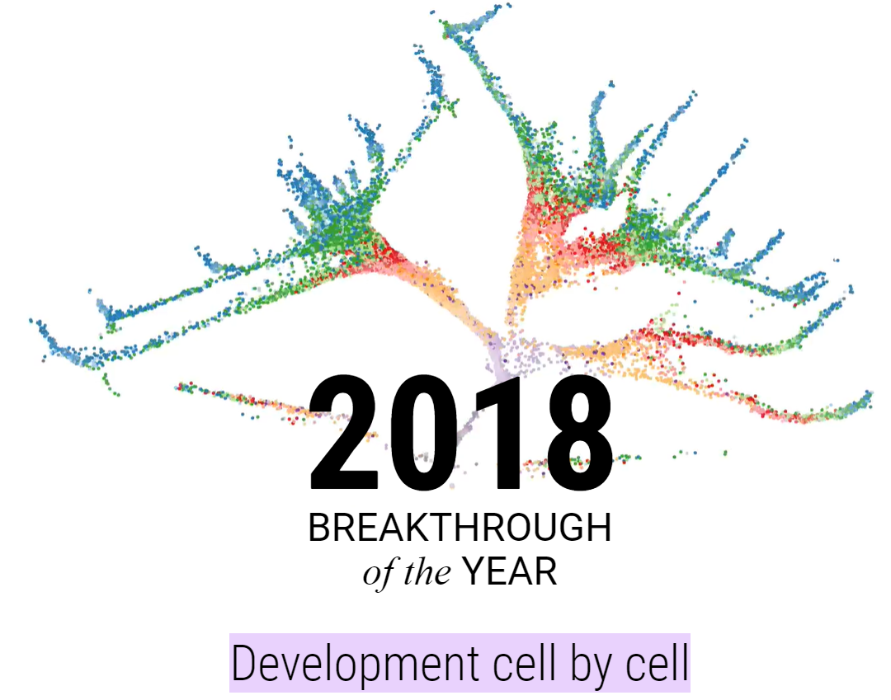
“The single-cell revolution is just starting.”
Science, Vol. 360, p. 367, 27 April 2018
Single-cell multimodal omics
2019 Method of the Year

Slide 6
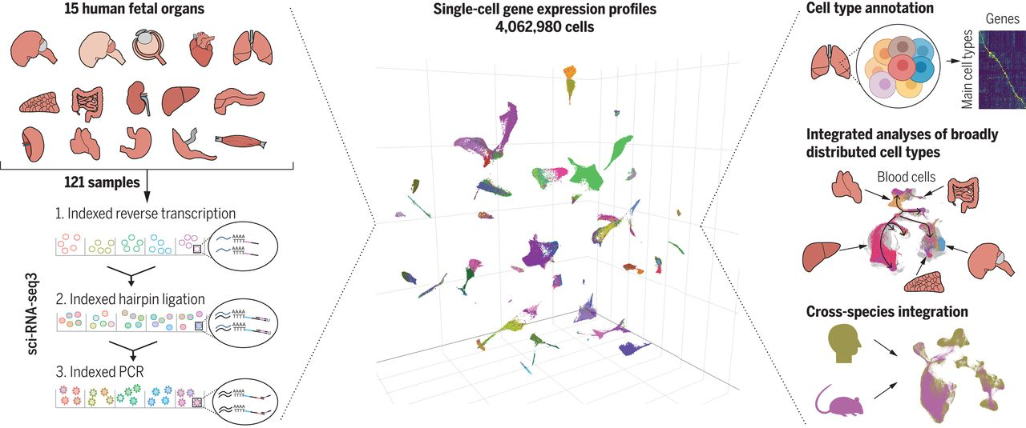
How do we handle all of this data?
Cao et al. A human cell atlas of fetal gene expression. Science, 2020 Nov 13;370(6518):eaba7721
4M rows of cells x 20k genes = 80B entries!

Slide 7
We will cover
Description of single-cell and spatial assays/platforms/protocols
Sample prep and experimental design concerns
Gene and cell filtering
Normalization
Dimensionality reduction
Clustering and cell annotation
Data integration
Differential expression
Trajectory inference

Slide 8
Participation time!
Who has (or will soon generate) single-cell RNA data?
Who has (or will soon generate) single-cell DNA data?
Who has (or will soon generate) single-cell protein data?
Who has (or will soon generate) spatial data?
Anybody working with all of the above?

Slide 9
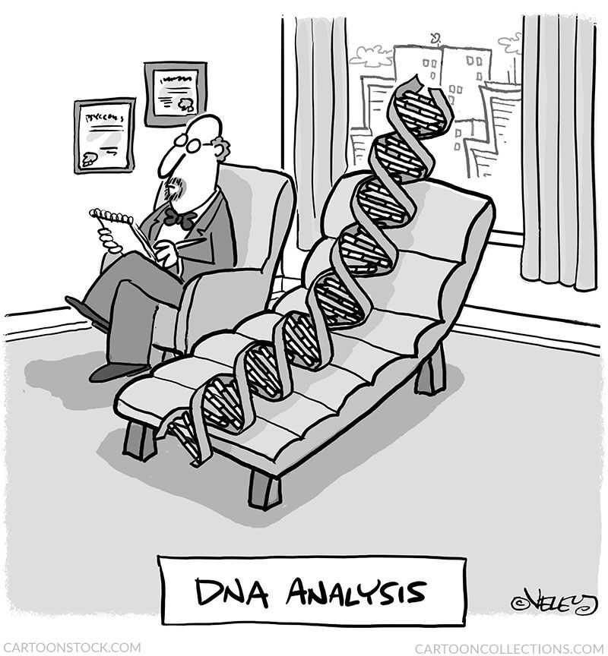
scDNA-seq
WG(B)S (whole genome (bisulfite) sequencing)
DIY methods – Miao’s multiomics lecture
Commercial methods – BioScryb, Scale
Chromatin structure and accessibility
ATAC-seq, ChIP-seq, Hi-C, etc.
DIY methods – Miao’s multiomics lecture
Commercial methods – 10x Genomics (end of this lecture)
Copy number variation (CNV) and single nucleotide variation (SNV)
DIY methods – Miao’s multiomics lecture
Commercial methods – Mission Bio

Slide 10
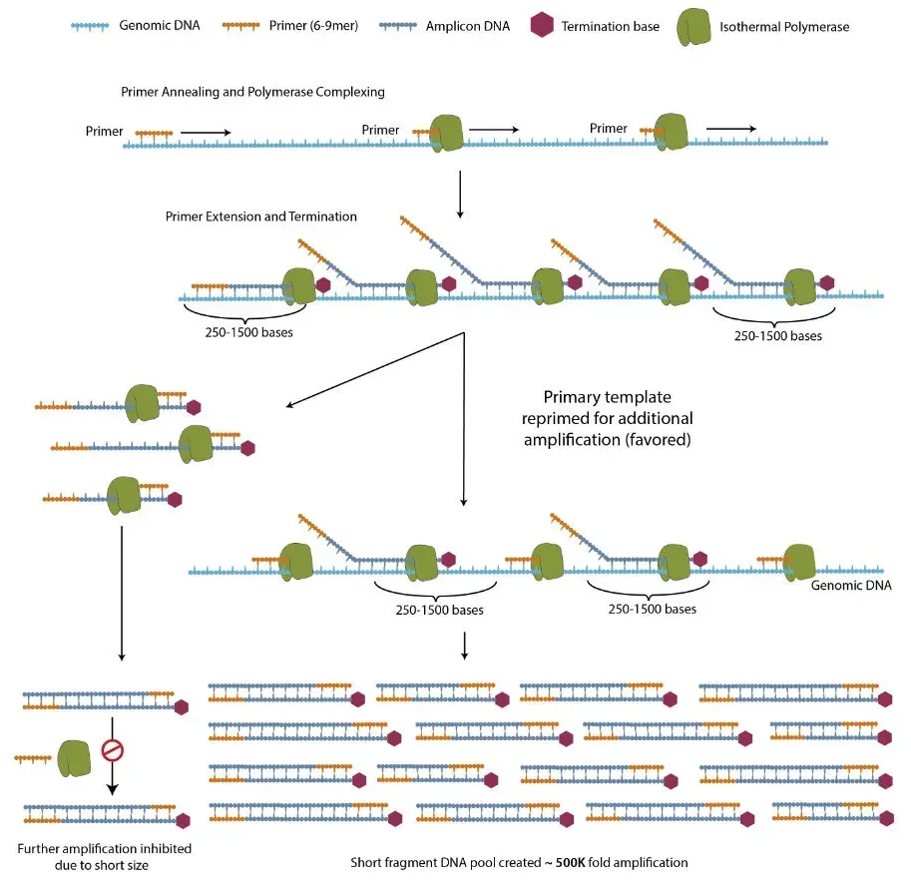

BioScryb
No instrument required!
WGS with PTA
(primary template-directed
amplification)

Slide 11

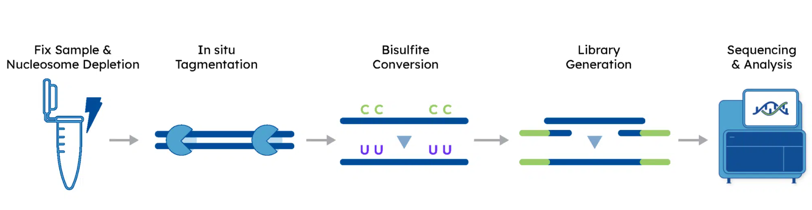
Scale Biosciences
NEW single-cell methylation kit
Up to 18k cells / run
Capture-compatible

Slide 12
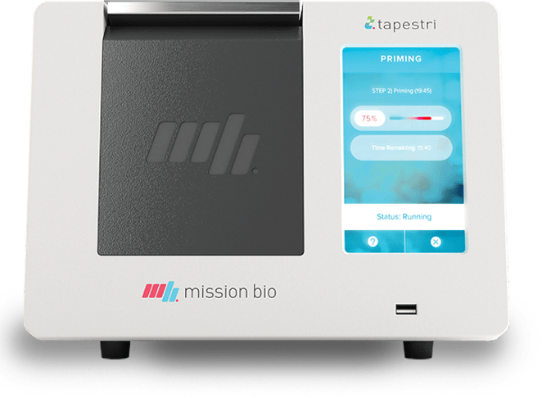
CNV and SNV detection – Mission Bio
Tapestri platform
Droplet-based amplification
Up to 10k cells
Panel-based PCR (up to 400 targets)
Can call both CNVs and SNVs in target regions
NEW multiomics application: Protein + DNA

Slide 13
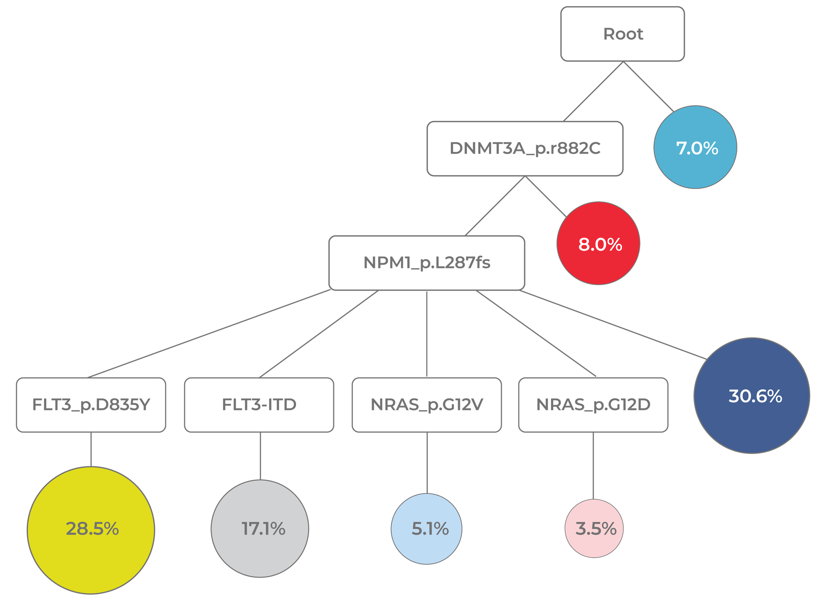
Track clonal evolution (AML)
Morita, K. et al. Nature Communications (2020)

Slide 14
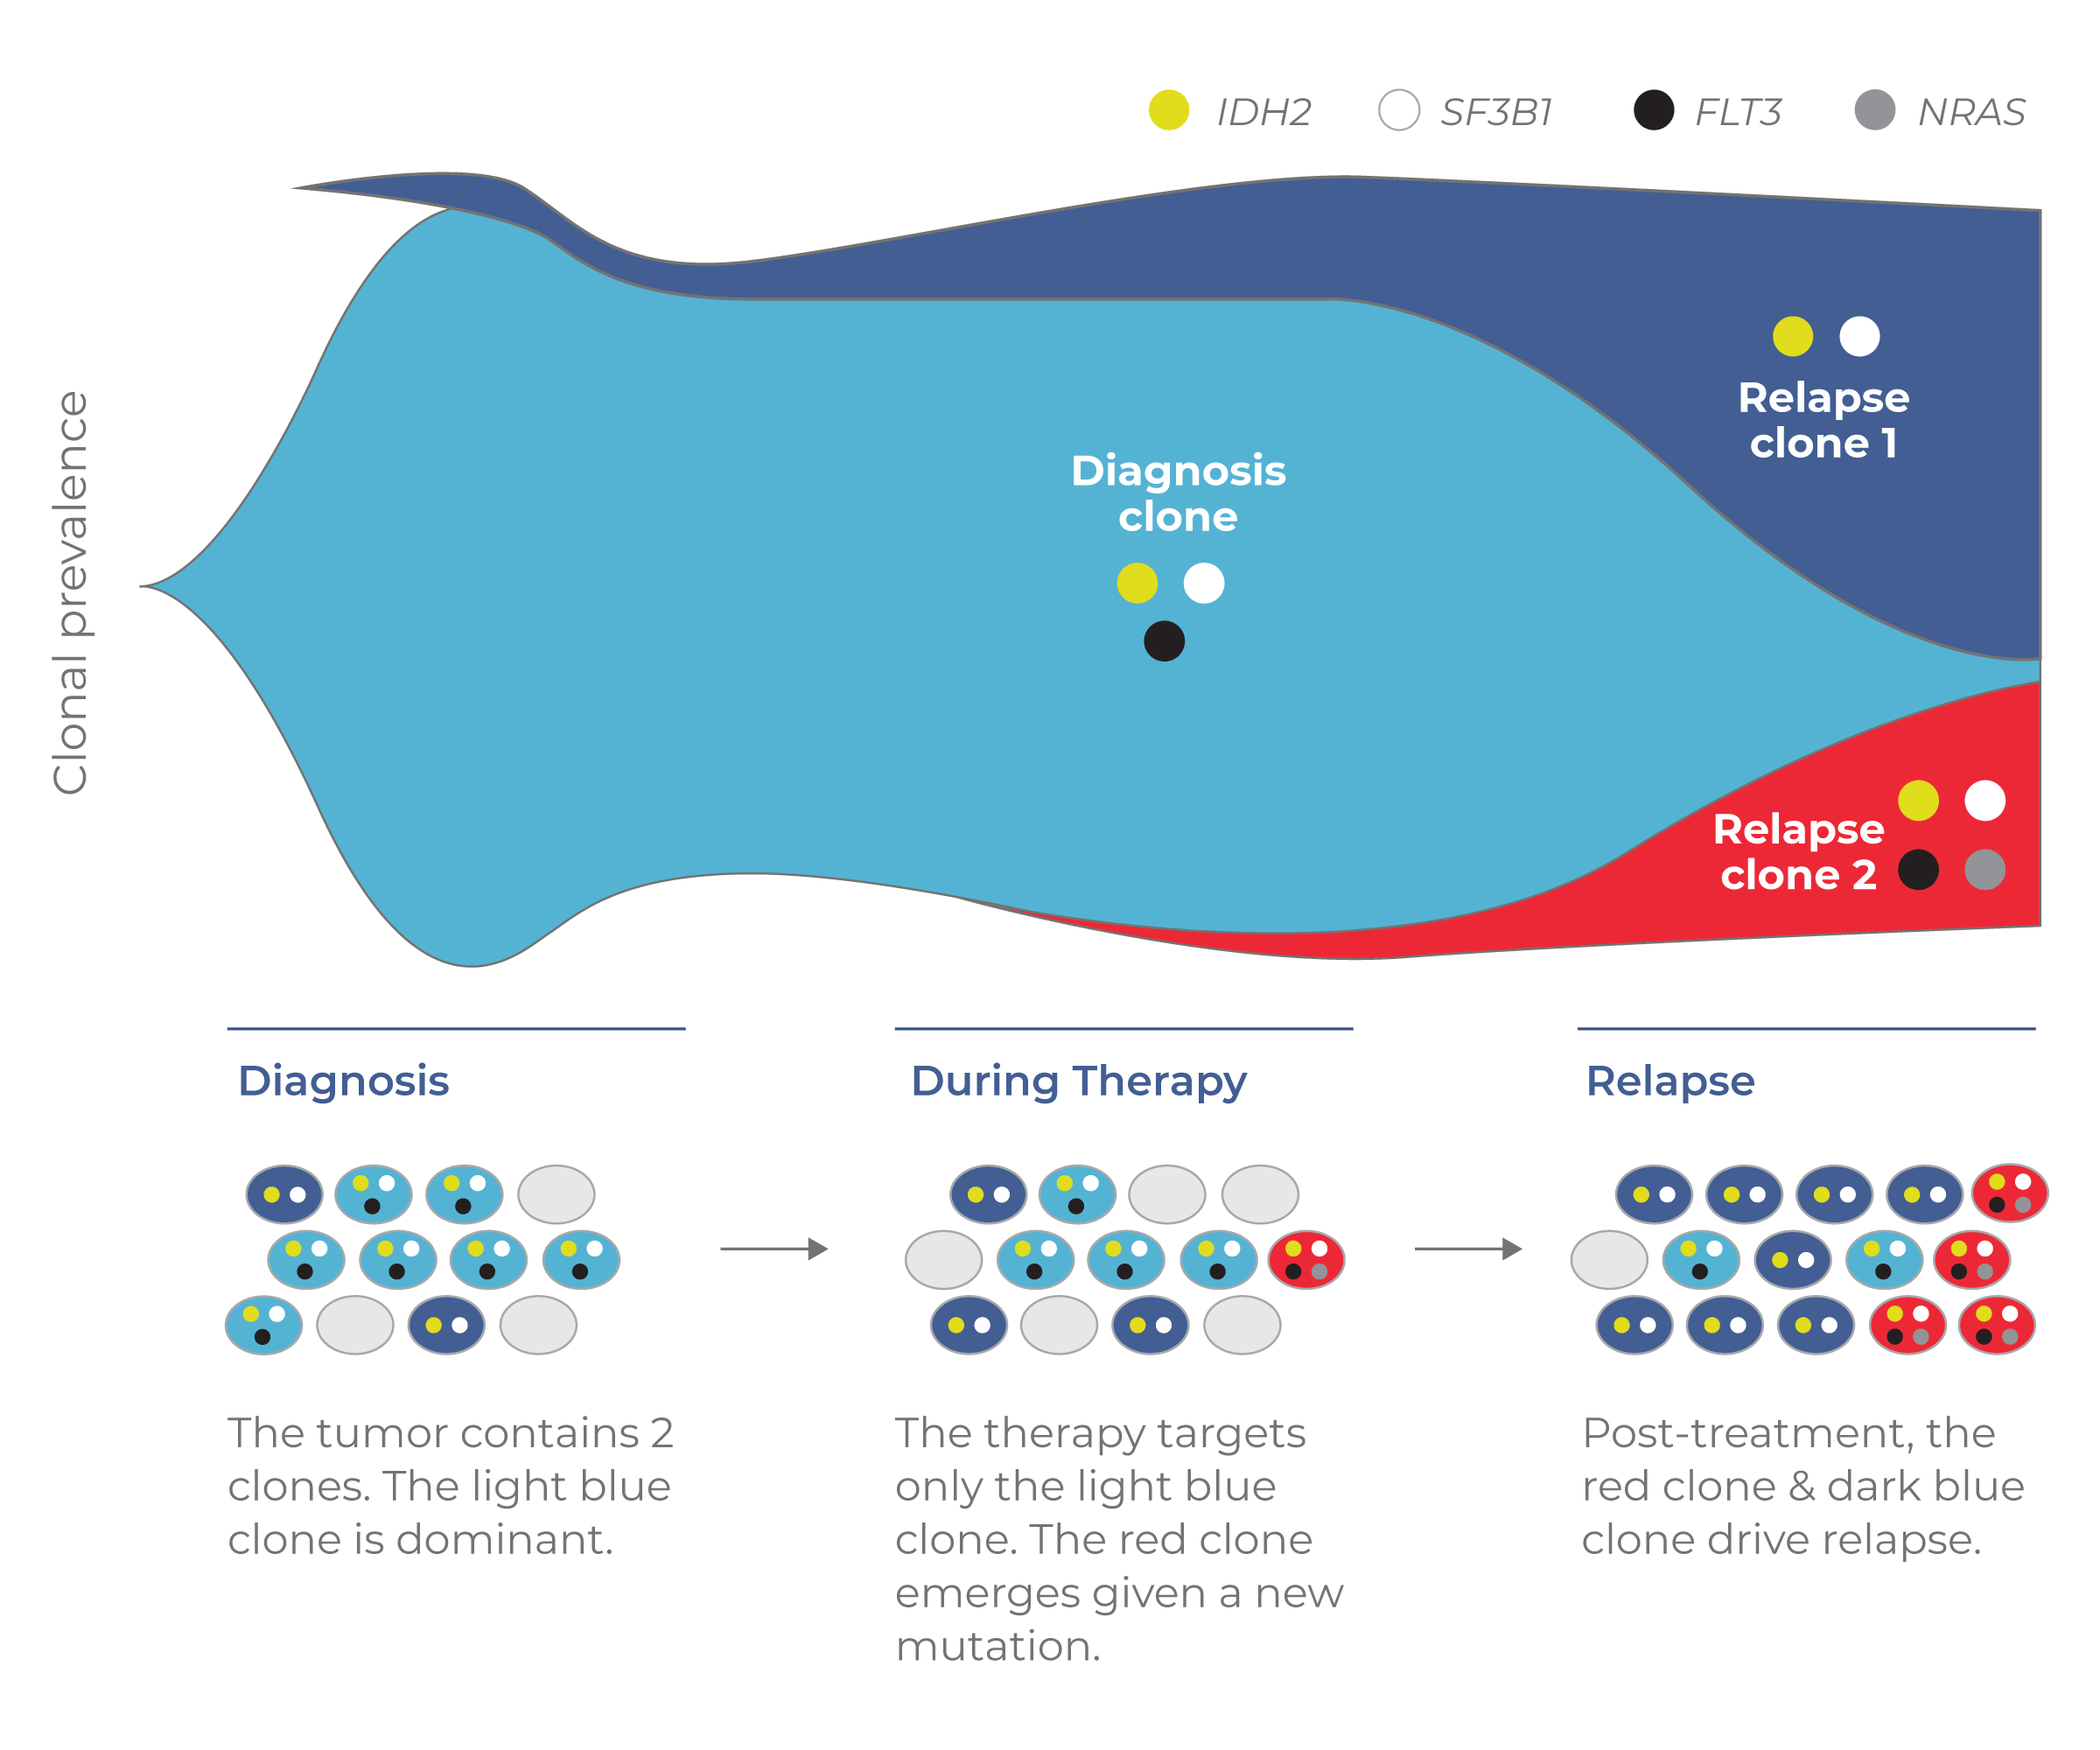
Reveal therapy resistance
McMahon, C.M. et al. Cancer Discovery (2019)

Slide 15
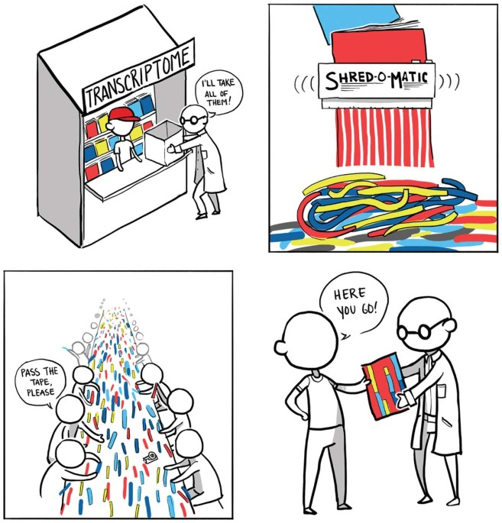
scRNA-seq
MANY different assays
Some commercial, some DIY
Full transcriptome vs 3’ vs 5’
Automation varies
Throughput varies
Cost varies
Microwell-based
Plate-based
Droplet-based
Ian Korf for Nature Methods 10, 1165-1166 (2013)

Slide 16
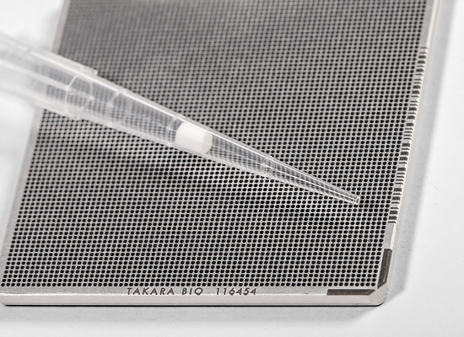
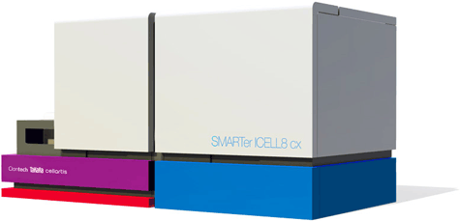
iCELL8 cx
Available at ErasmusMC (Biomics facility)
Uses 5184 nanowell chip, ~1800 cells loaded
Compatible with immunofluorescence
Protocols for single-cell
SMART-Seq full-length transcriptome analysis
Differential expression by 3' end counting
TCR profiling and 5' end differential expression
ATAC-seq

Slide 17
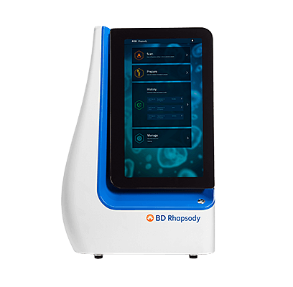
BD Rhapsody
Works with targeted panels to reduce sequencing costs
Immune response human/mouse
T-cell
Oncology – breast cancer
Custom panel add-ons
Up to 400 amplicons / sample
Includes UMIs to reduce PCR amplification bias
Increased flexibility
Archiving up to 3 months
Sub-sampling

Slide 18
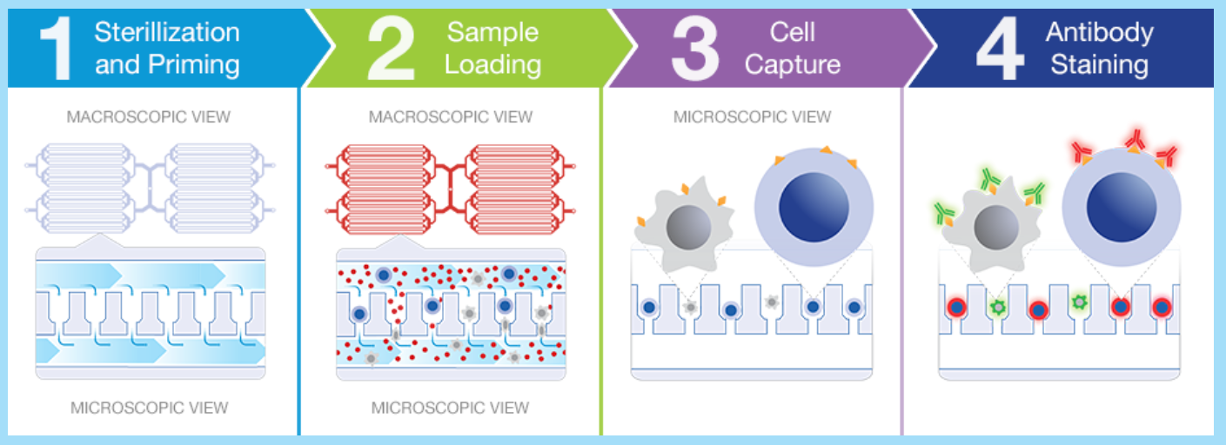
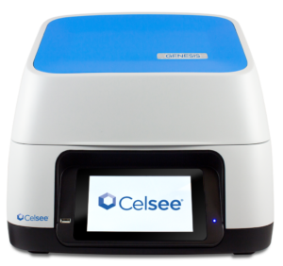
Celsee Genesis platform

Slide 19

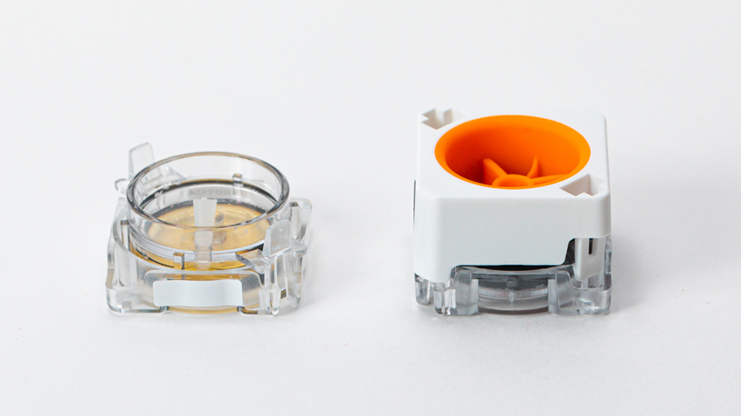
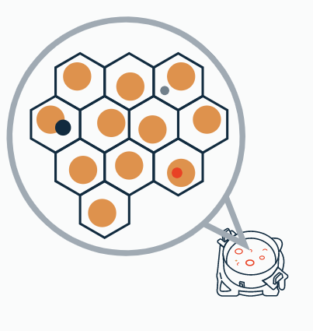
Honeycomb
The HIVE - portable, single-use microwell chip
Store samples up to 9 months

Slide 20
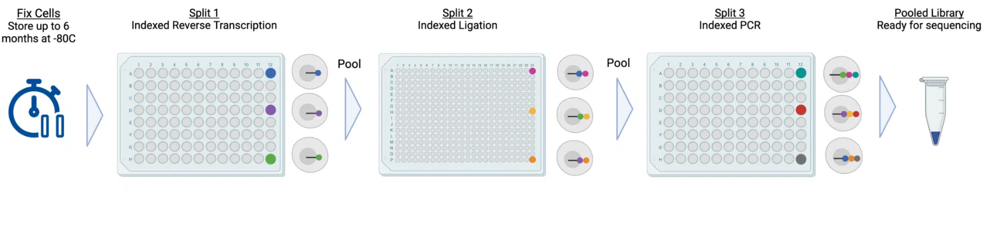
Scale Biosciences
No instrument required!
Based on sci-RNA-seq
Fix and store up to 6 months

Slide 21
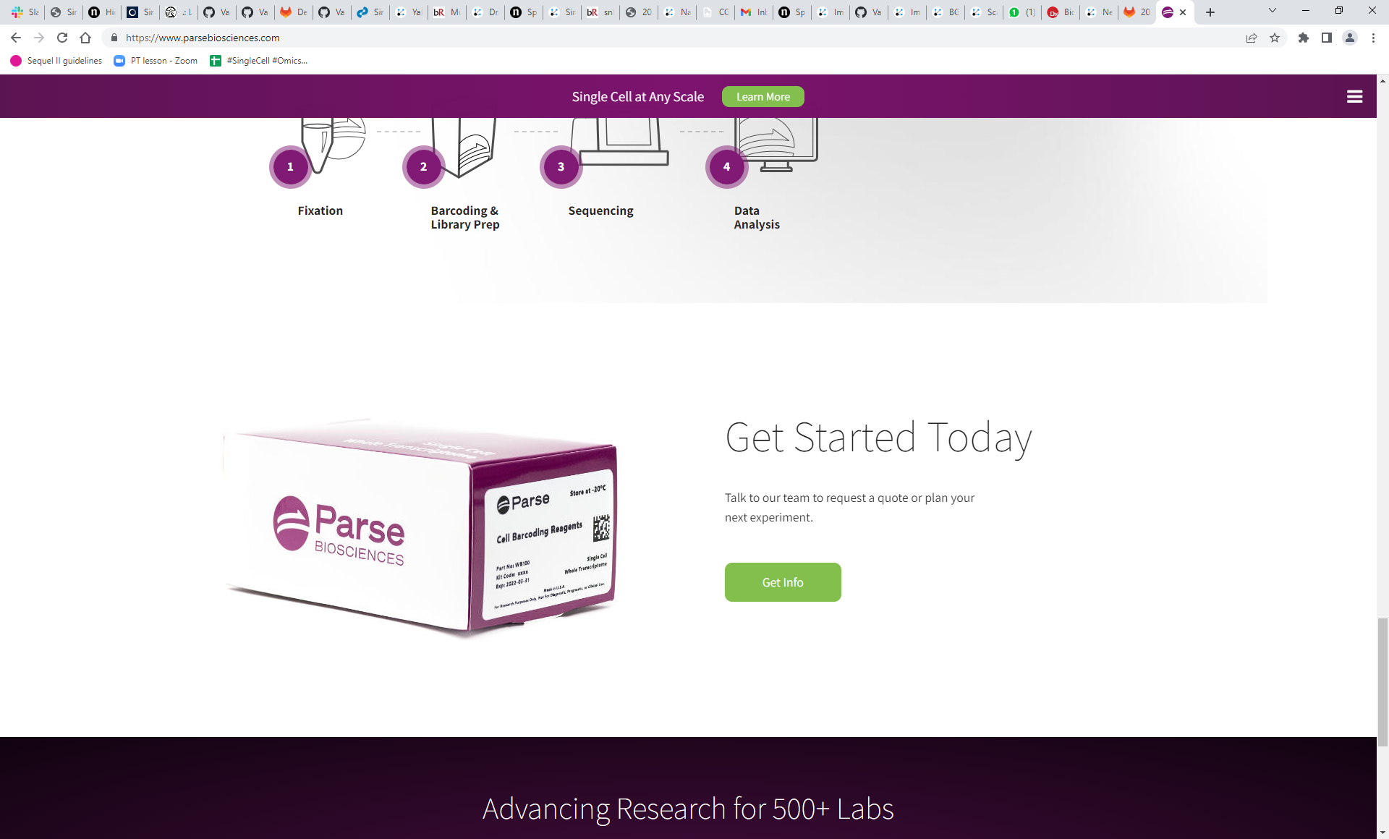
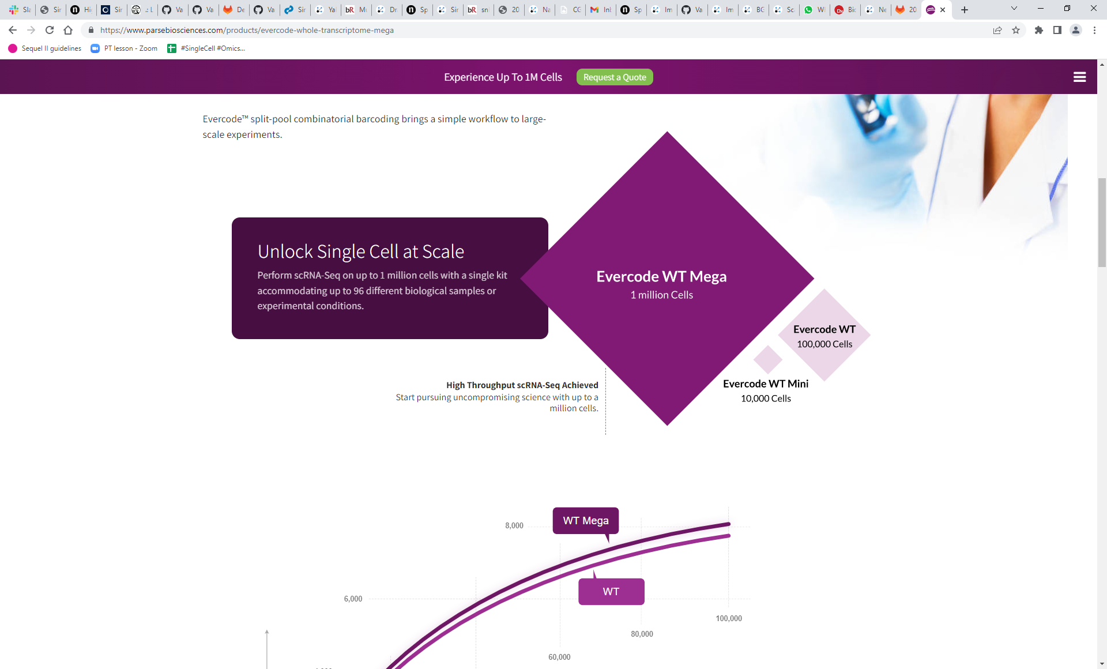
Parse Biosciences
No instrument required!
Based on SPLiT-seq
Fix and store up to 6 months

Slide 22
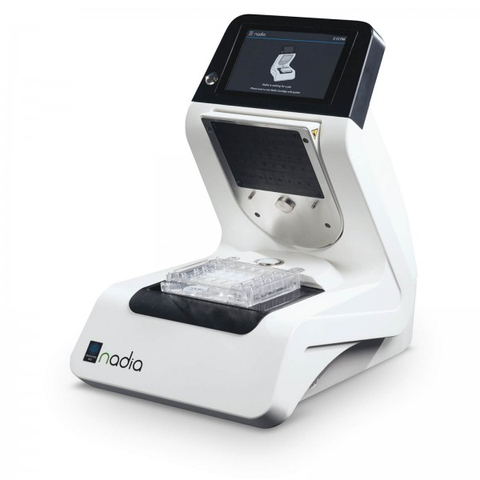
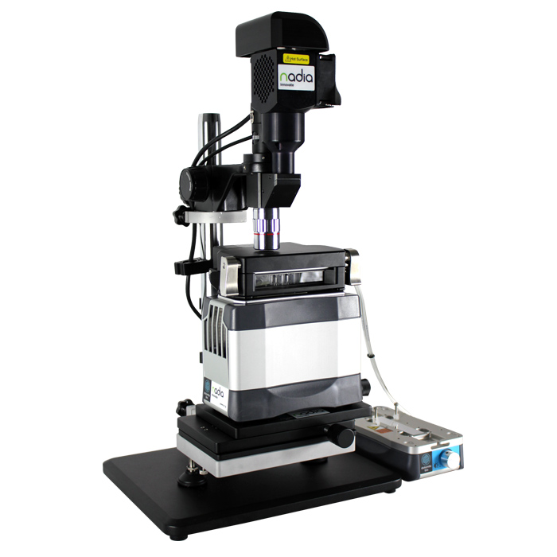
Dolomite Bio
Nadia Instrument and Nadia Innovate
Commercialized Drop-seq
scRNA-seq
Plant protoplast RNA-seq
snATAC-seq
Protocol development
Agarose droplet formation

Slide 23

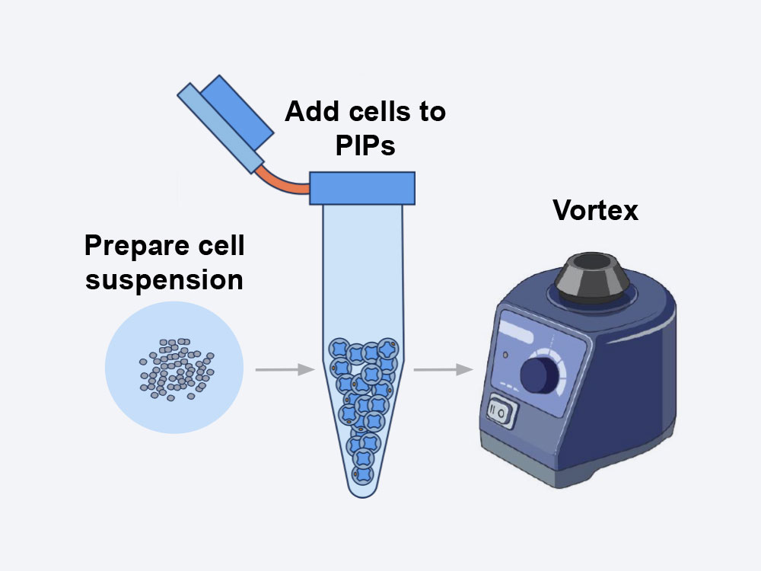
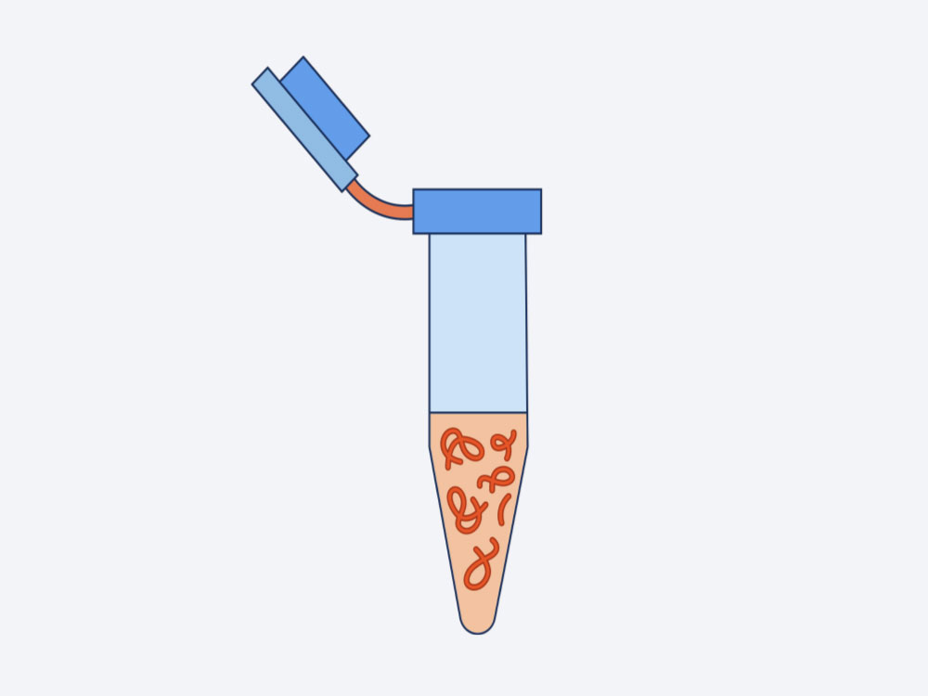
Fluent Biosciences
No instrument required!
Based on PIP-seq (particle-templated instant partition)
~5 min for encapsulation
Thermocycler does the rest
1 tube library prep based on standard Illumina workflows

Slide 24

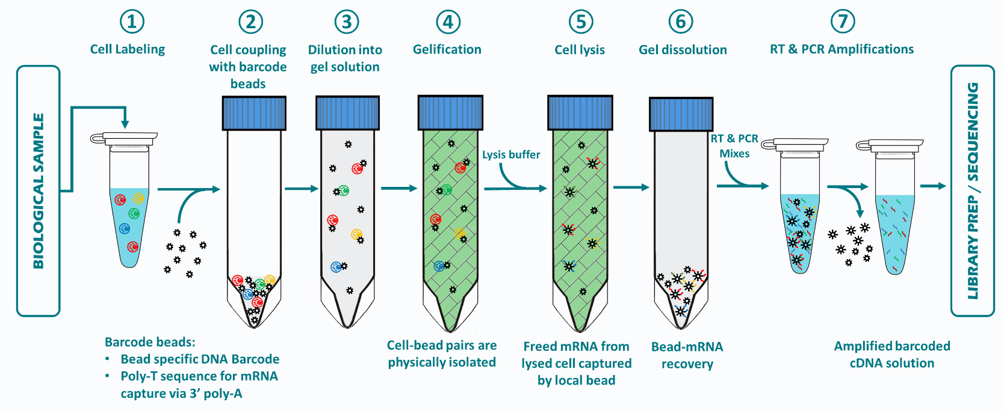
Scipio Bioscience
No instrument required!
Based on hydrogels for reaction compartmentalization

Slide 25
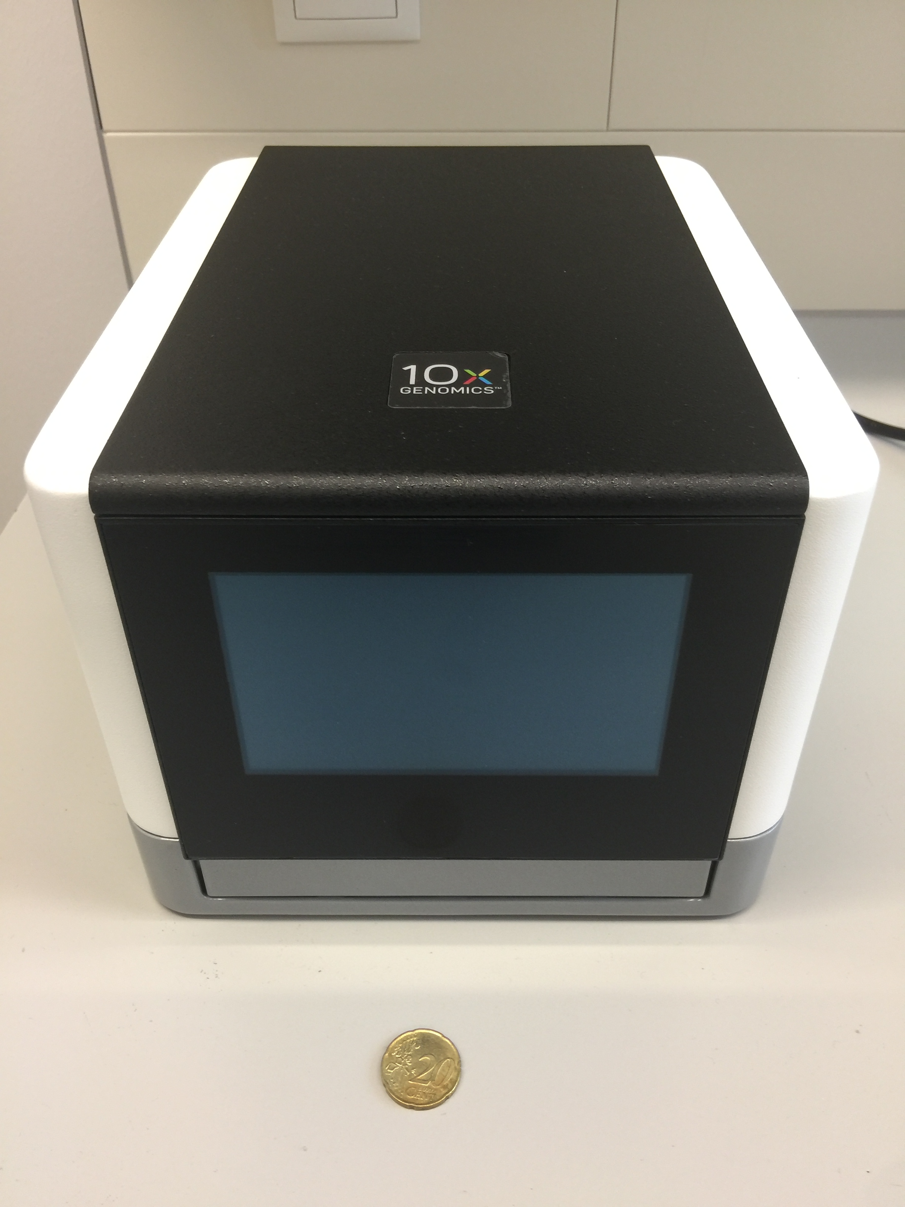
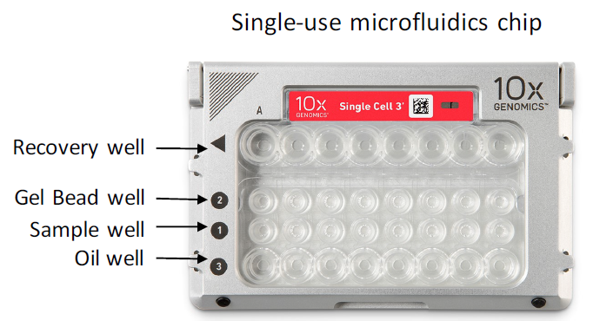
10x Genomics Chromium Controller
Commercial launch early 2016
Microfluidics system for reaction
compartmentalization
High throughput, up to 80k cells/run
High capture rate, ~50%

Slide 26
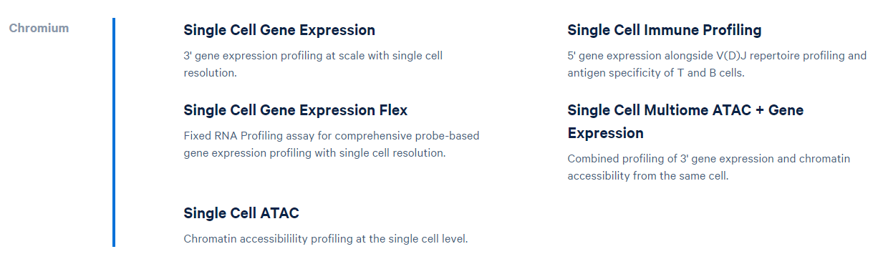
10x Genomics single-cell products

Slide 27
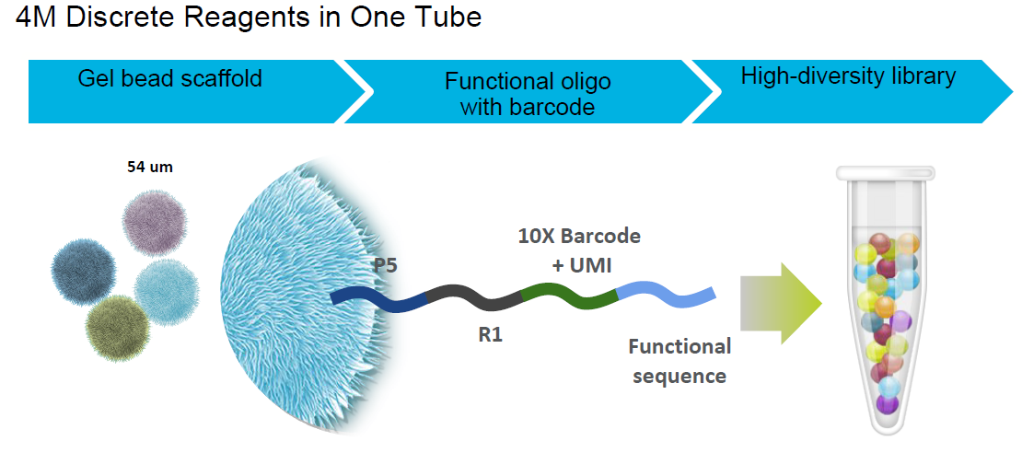
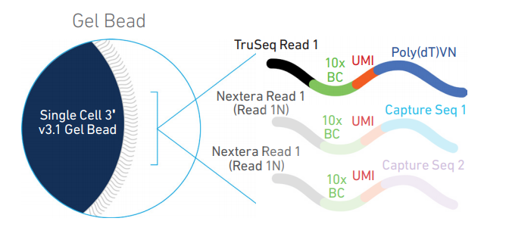
Gel beads up close
10x Barcode (16bp): unique for each GemBead
+ UMI (12bp): correct for PCR duplicates

Slide 28
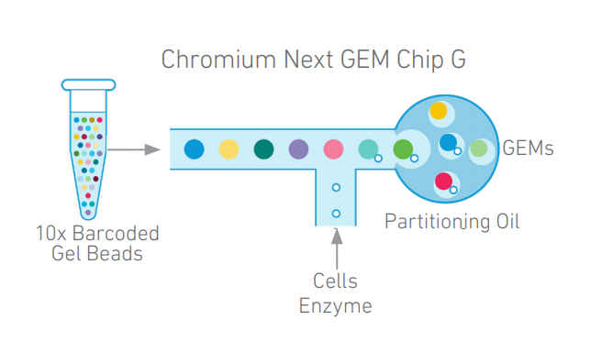
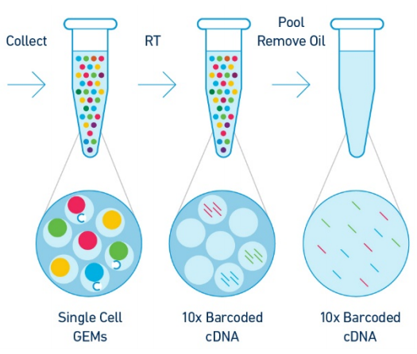
Gel bead in Emulsion (GEM) technology

Slide 29
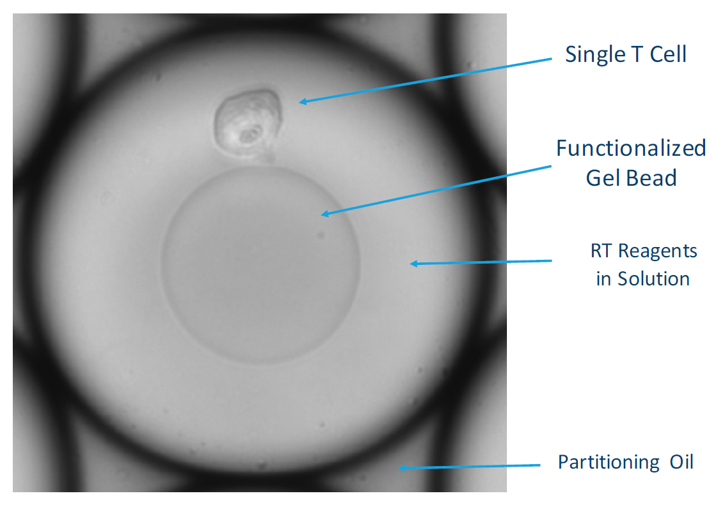
GEMs up close

Slide 30
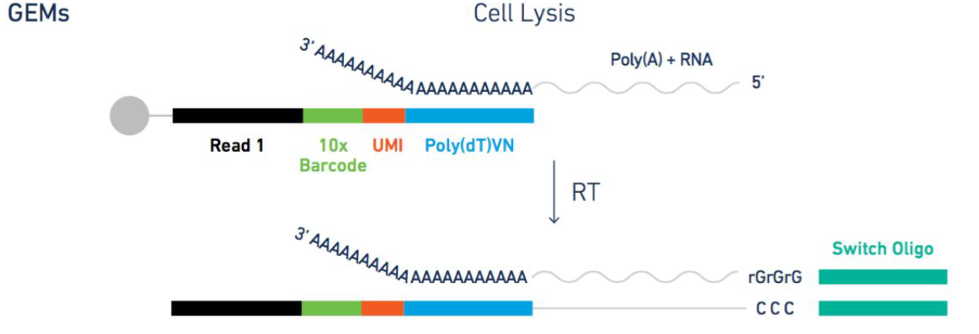
Assay scheme for 3’ mRNA sequencing

Slide 31
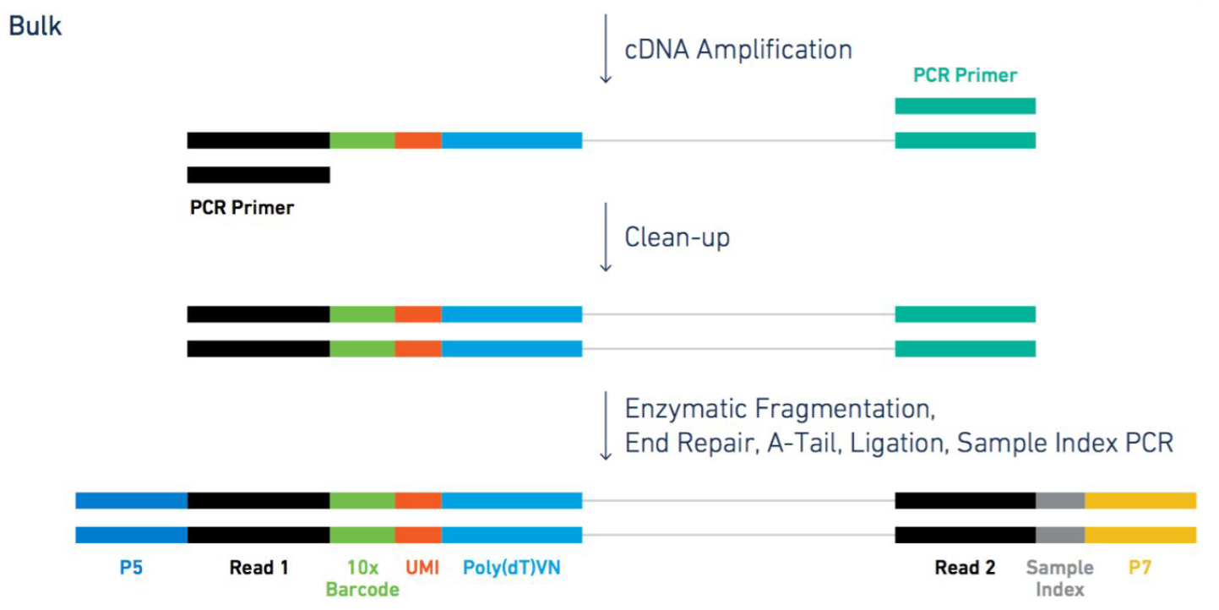
Assay scheme for 3’ mRNA sequencing

Slide 32
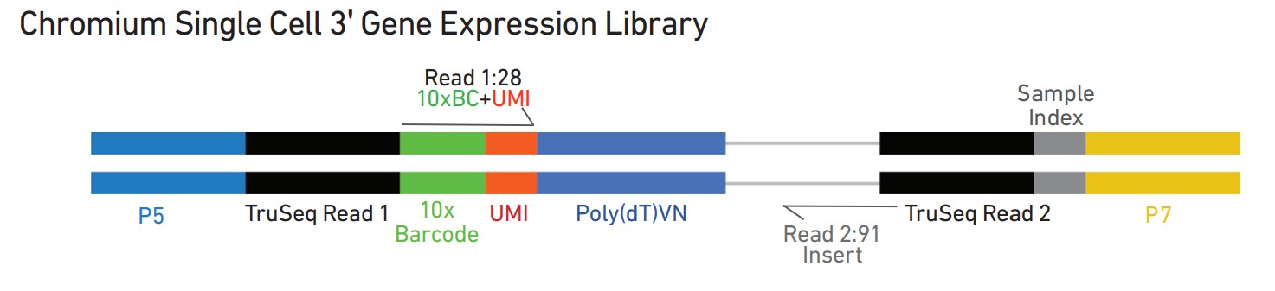
Final library structure

Slide 33
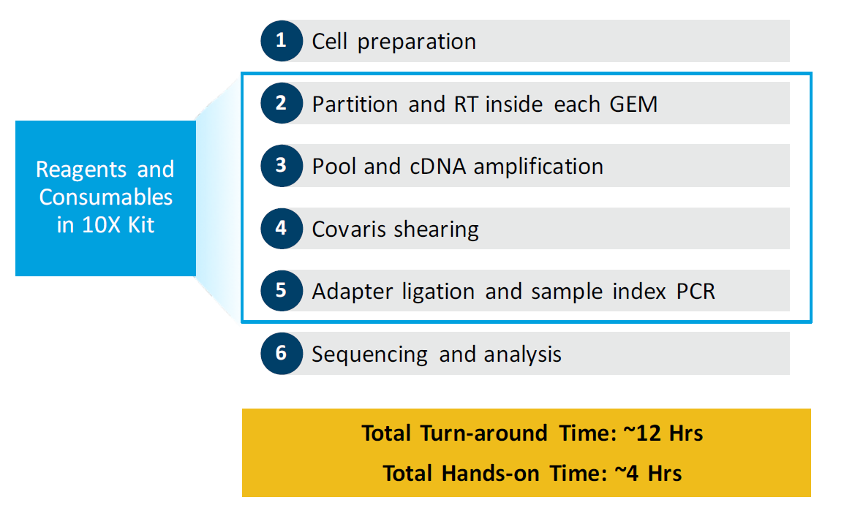
Single cell 3’ end-to-end workflow
Fragmentation

Slide 34
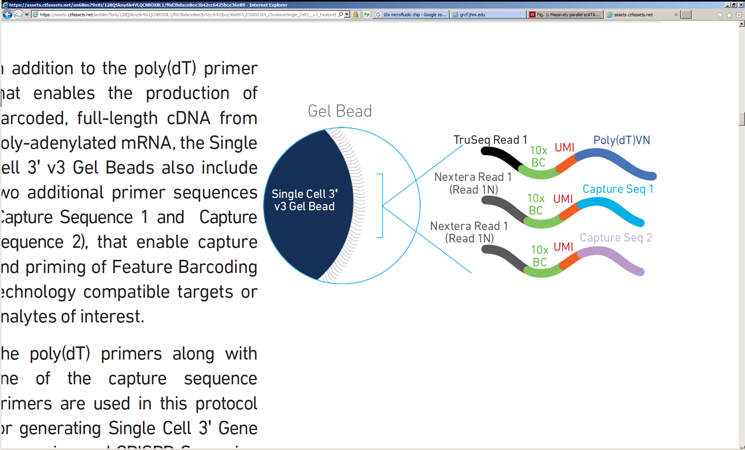
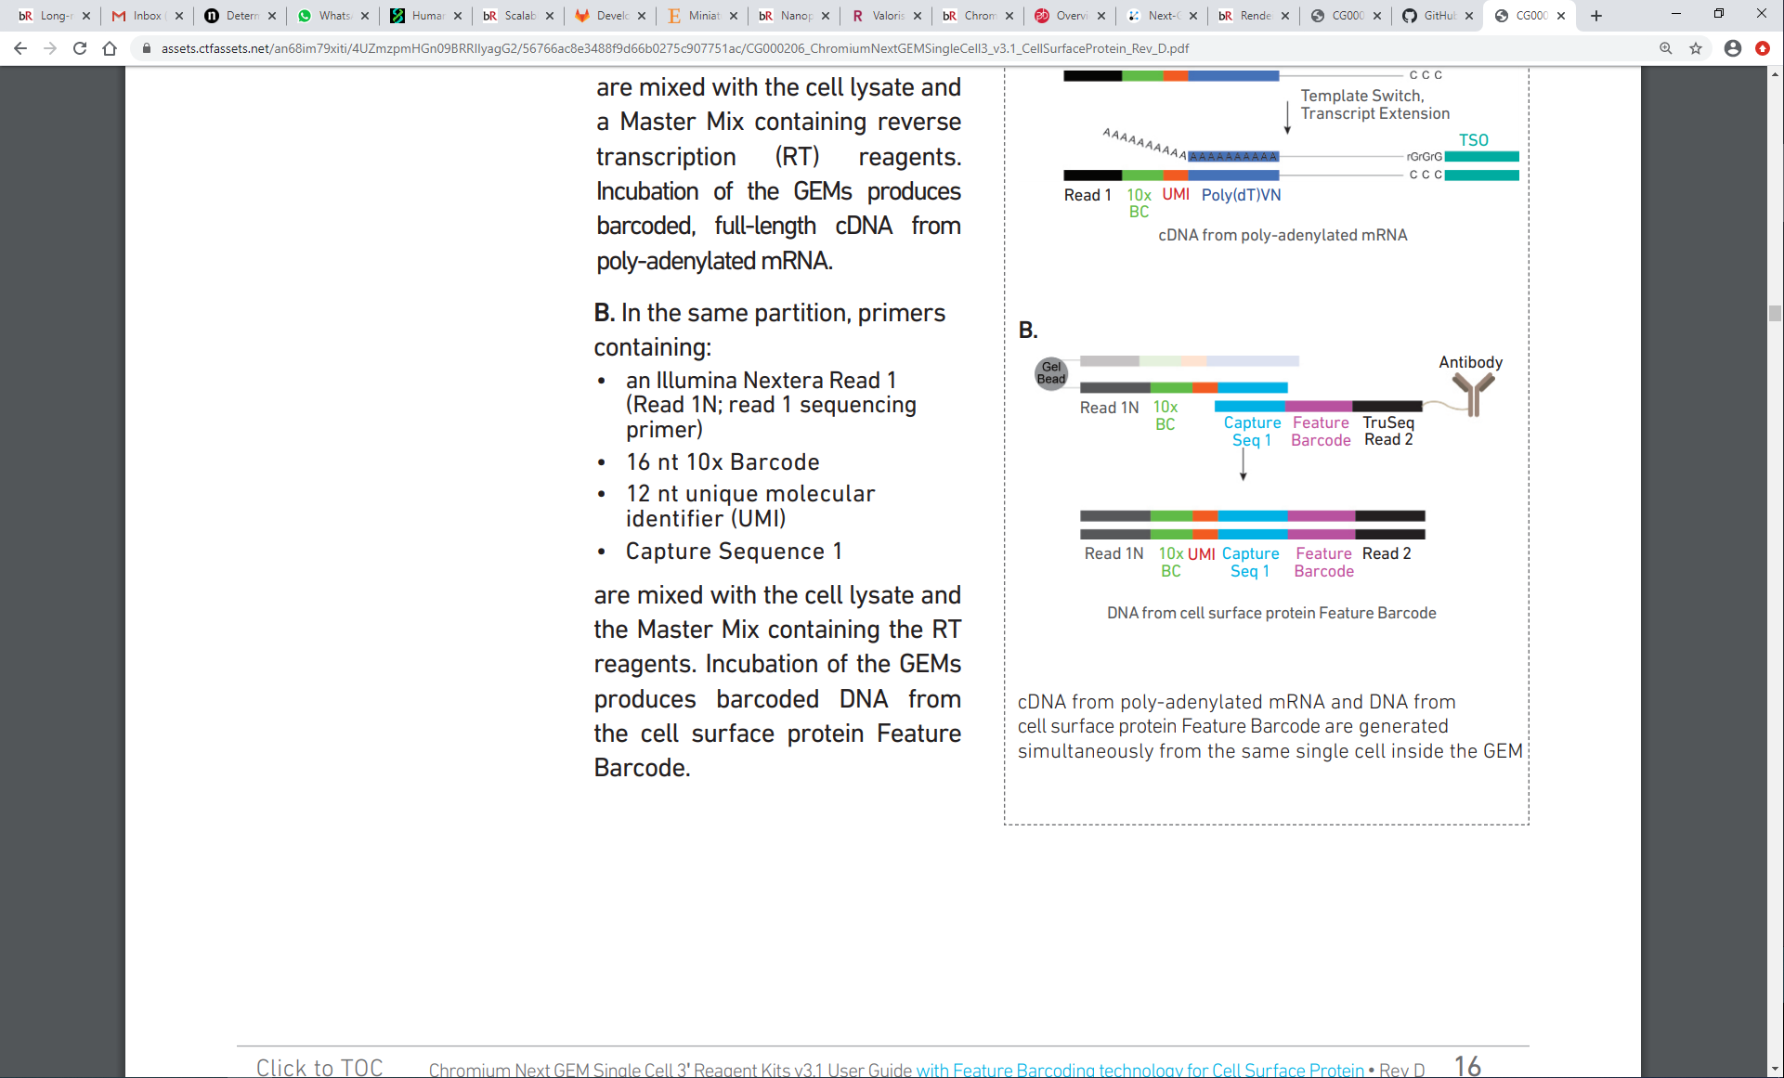
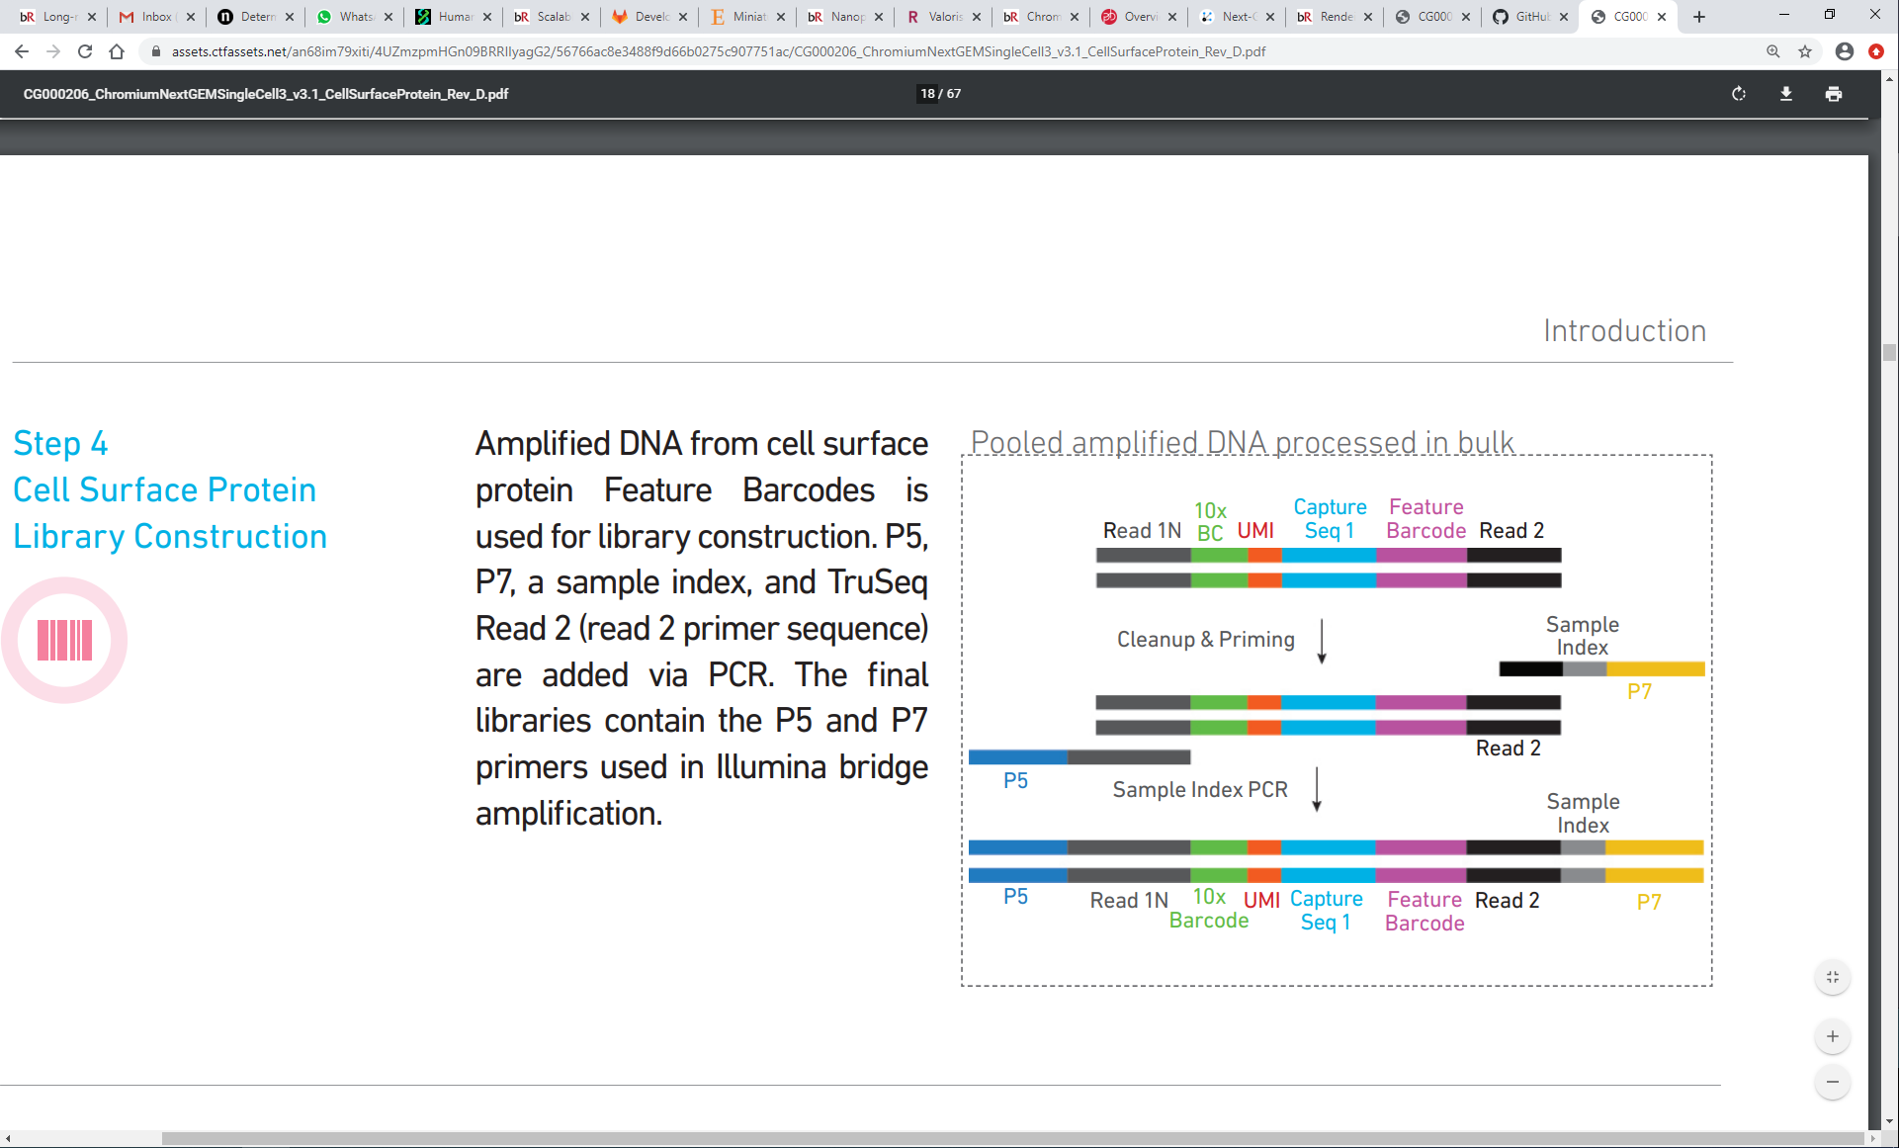
Single cell 3’ feature barcoding

Slide 35
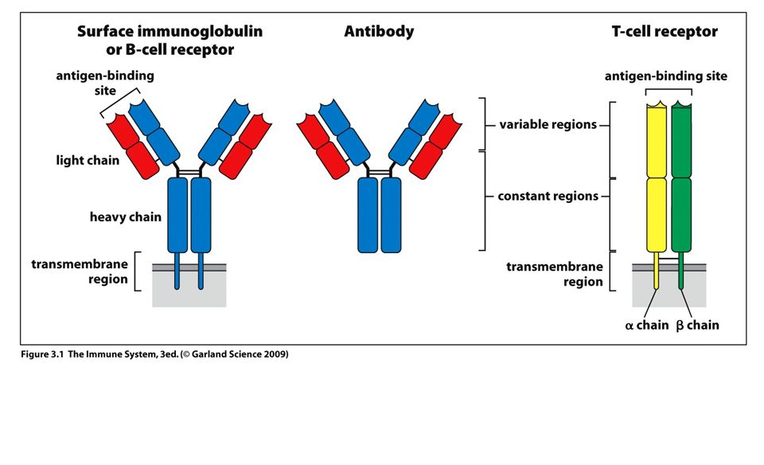
Structure of T and B cell receptors

Slide 36
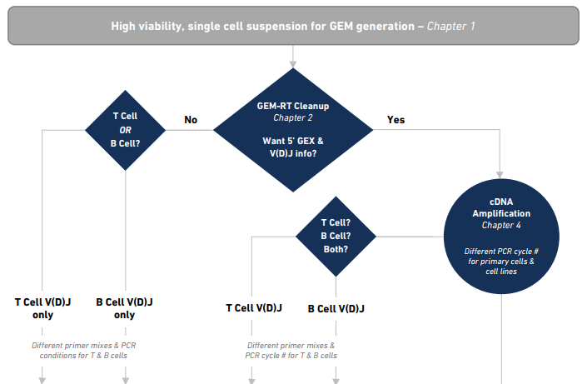
General workflow 5’ + V(D)J single cell sequencing

Slide 37
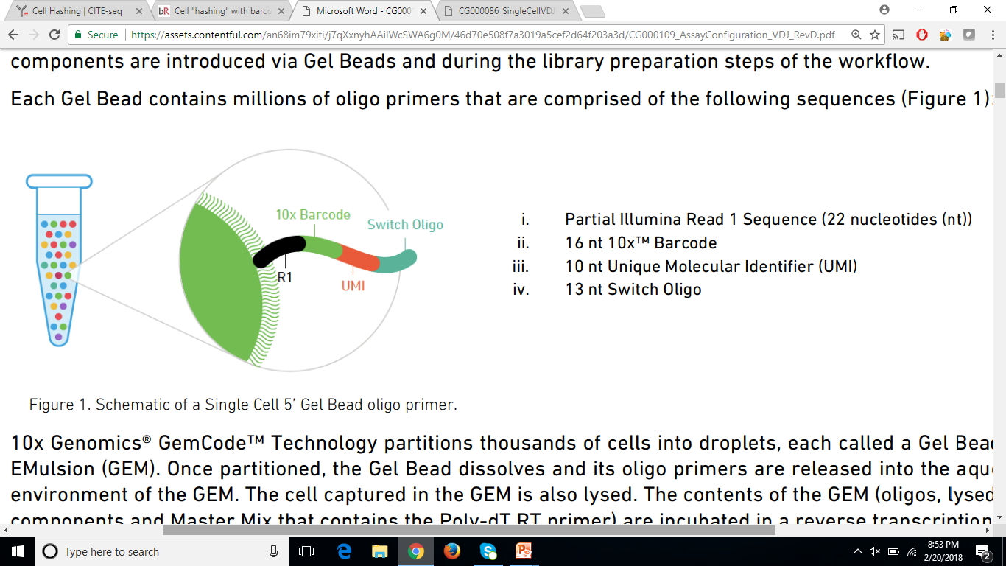
Gel bead oligos

Slide 38
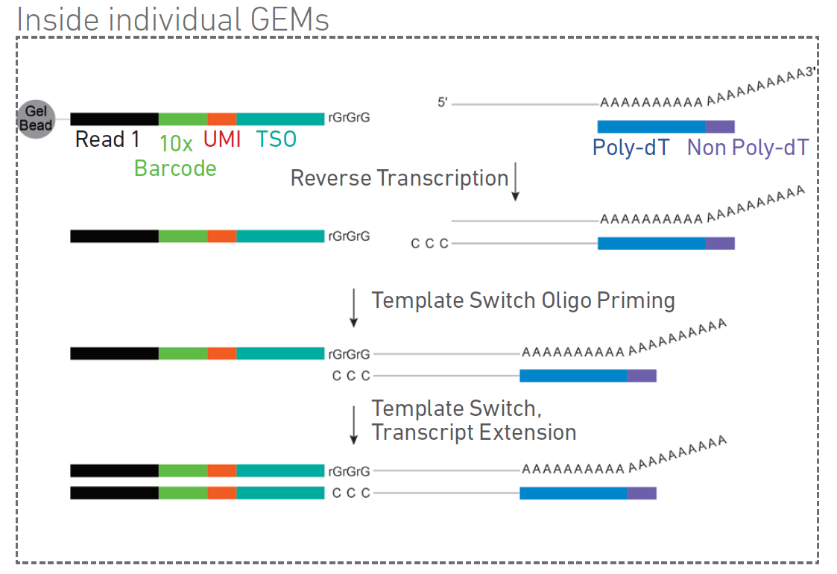
Assay scheme for 5’ scRNA-seq

Slide 39
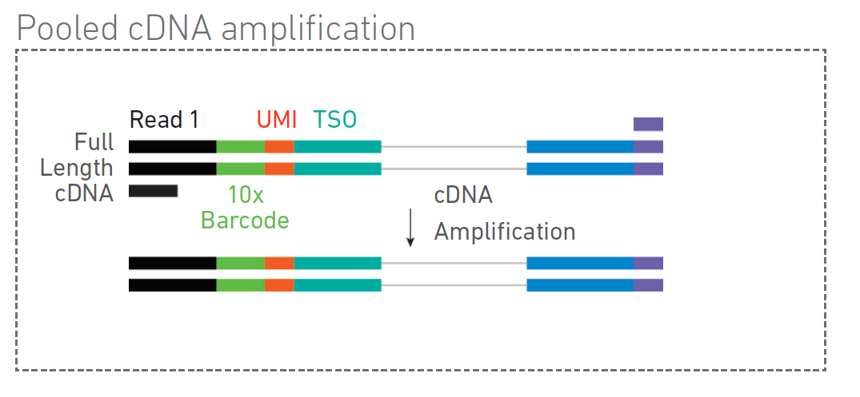
Assay scheme for 5’ scRNA-seq

Slide 40
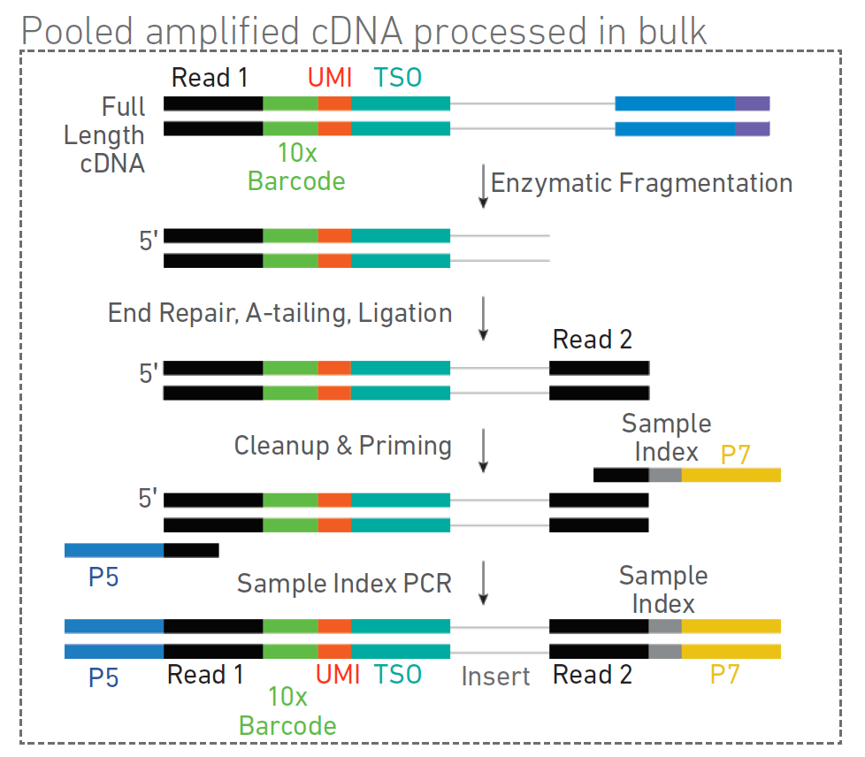
Assay scheme for 5’ scRNA-seq

Slide 41
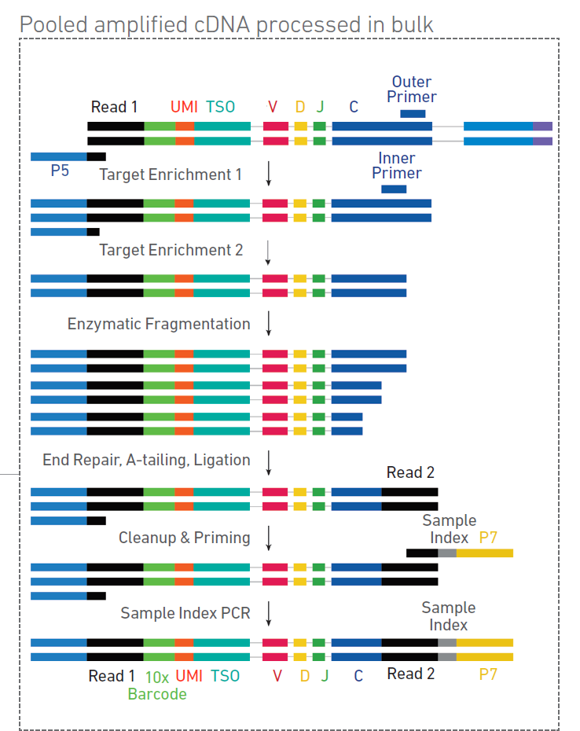
Assay scheme for 5’ VDJ libraries

Slide 42
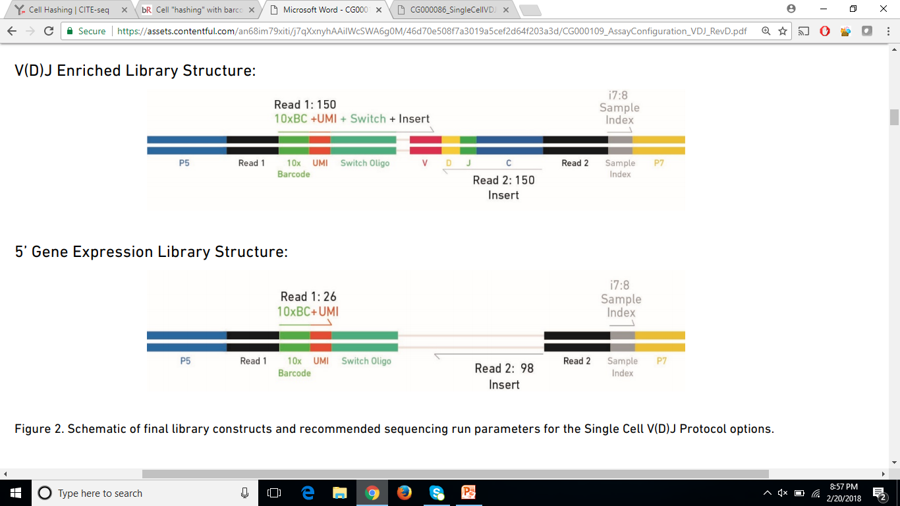
Final library structure

Slide 43


NEW! Chromium X

Slide 44


Single-cell ATAC-seq

Slide 45

Scale Biosciences
Pre-indexing kit compatible with 10x Genomics snATAC-seq

Slide 46


Single-cell multiome (ATAC and RNA)

Slide 47

Questions or concerns?
?
?
S.L.Kloet@lumc.nl
info@lgtc.nl
!

